Slide 1
Apache Kafka
Max Petrov,
ITMO University, Saint Petersburg, Russia
max93petrov@gmail.com
Saint Petersburg, Finland, 2017
Notes:
Hello, My name is Max and I’m happy present out work : Modelling multistage information spreading in dynamic complex networks
~10 sec

Slide 2
Agenda
Introduction
Usage cases
Features
Architecture
Data model
Practice
Download, setup, run
Default producer and consumer
Python producer and Python/Java/Scala Spark consumers
Multi-node setup, run
Notes:
There are a lot of stydies that discribes information spreading in osn,
but its not takes into account interaction between network structure changes and dynamics information spreading
And we decided To assess the effectiveness of information spreading in dynamically reorganizing social networks
~ 30 sec

Slide 3
Introduction
Apache Kafka is an open-source stream processing platform developed by the LinkedIn and supports Apache Software Foundation written in Scala and Java.
Kafka is used for building real-time streaming apps.
It is horizontally scalable, fault-tolerant, fast.

Slide 4
Usage cases
General: Real-time data processing systems
Example: Traffic Data Monitoring Application

Slide 5
Features
Feature | Description
Scalability | Distributed system scales easily
Reliability, Durability Fault-Tolerance | Replicates data, supports multiple subscribers, and automatically balances consumers in case of failure
Performance | High throughput and low latency ~100 000 messages/sec, ~ 1 sec for one node

Slide 6
Architecture
Notes:
Zookeeper – you start this before Kafka. ZooKeeper is used for managing, coordinating Kafka broker. So each node in the cluster knows when a new broker joined, a Broker died, a topic was removed or a topic was added,
Producers – consume the data feed and send it to Kafka for distribution to consumers.
Consumers – applications that subscribe to topics; for example, a custom application or any of the products listed at the bottom of this post.
Brokers – workers that take data from the producers and send it to the consumers. They handle replication as well.
Partitions – the physical divisions of a topic, as shown in the graphic below. They are used for redundancy as partitions are spread over different storage servers.
Topics – categories for messages. They could be something like “twitter_messages” or “vk_messages”.
It can be noticed that for one topic, partitions can be located on different brokers to archive concurrent reading

Slide 7
Topic partitions
Concurrent writes to the topic for producers
Partitions can be different lengths
Time based sorting
Specific partition reads for consumers
Possibility to obtain offsets without reading data

Slide 8
Partition offsets
Producers writes to tail of the partition
Consumers have independent offsets
Consumer can save (commit) offsets while reading and continue reading from saved offset if it fall down to archive exactly once semantic
Notes:
Коммит оффеста нужен для реализации различных типов семантики: раз exactly once, atleast once

Slide 9
Practice

Slide 10
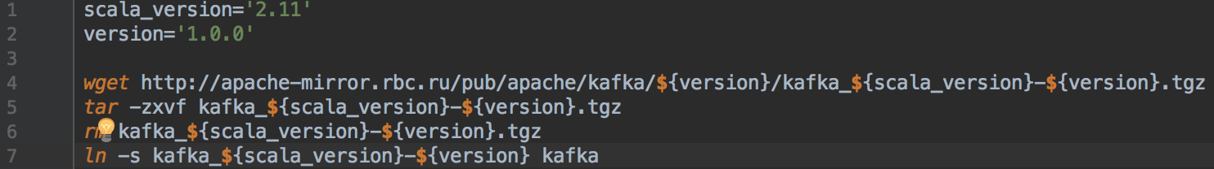
Download and extract
Configuration
Change parameters:
listeners=PLAINTEXT://127.0.0.1:9092
advertised.listeners=PLAINTEXT://127.0.0.1:9092
zookeeper.connect=127.0.0.1:2181

Slide 11
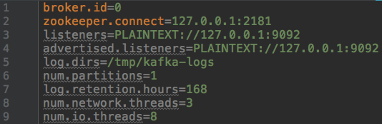
Important configuration parameters
Notes:
zookeeper.connect is used to zoo connect
listeners is what the broker will use to create server sockets.
advertised.listeners is what clients will use to connect to the brokers.
The two settings can be different if you have a "complex" network setup (with things like public and private subnets and routing in between).

Slide 12
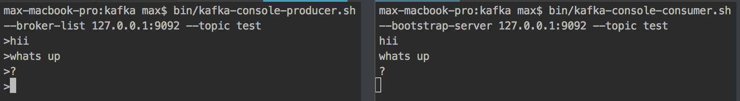
Run
Default producer and consumer
Notes:
run:
cd kafka
bin/zookeeper-server-start.sh config/zookeeper.properties bin/kafka-server-start.sh config/server.properties
advanced level:
nohup kafka/bin/zookeeper-server-start.sh kafka/config/zookeeper.properties > zoo.log &
sleep 1s
nohup kafka/bin/kafka-server-start.sh kafka/config/server.properties > kafka.log &
status:
ps aux | grep -v grep | grep 'kafka.Kafka\|QuorumPeerMain' | awk '{print $2}' | xargs kill -9

Slide 13
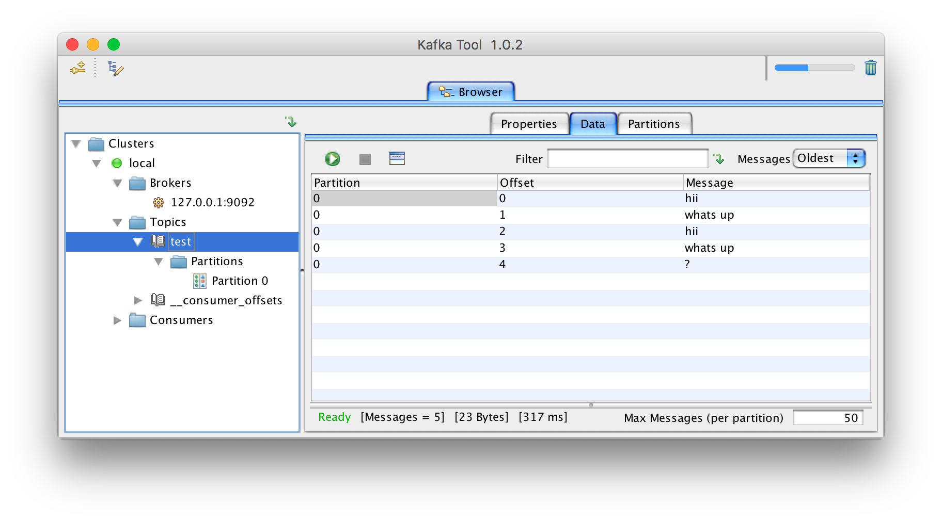
Kafkatool

Slide 14
Clients
C/C++, Python, Go, Erlang, .NET, Clojure,
Ruby, Node.js, Perl, PHP, Rust, Clojure, Swift
All opensource
Sync/asynchronous
Look at python, java, apache spark clients

Slide 15
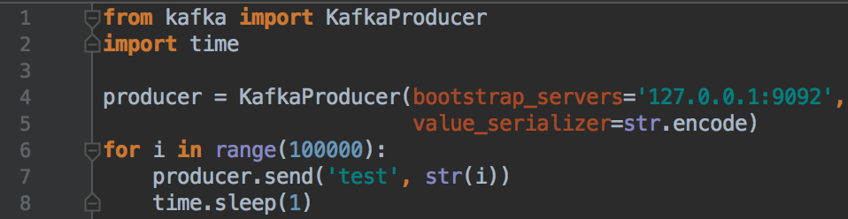
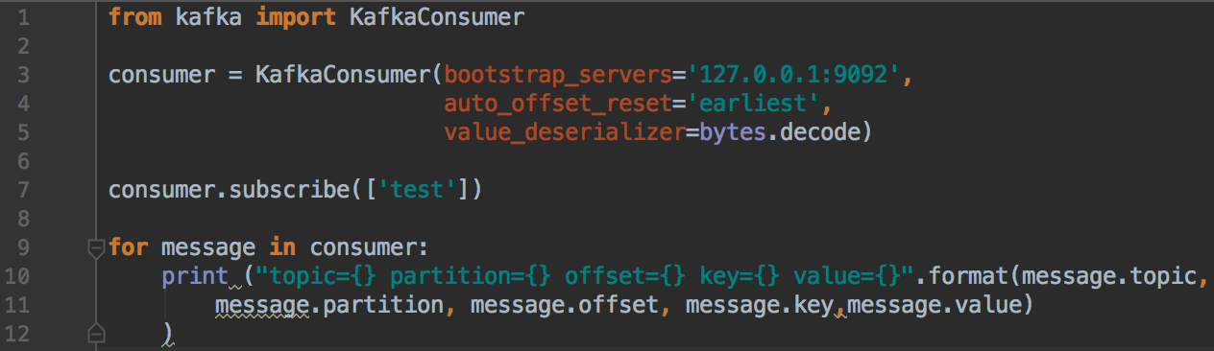
Python
Installation: pip install kafka-python
Producer
Consumer
Notes:
from kafka import KafkaConsumer consumer = KafkaConsumer(bootstrap_servers='127.0.0.1:9092', auto_offset_reset='earliest', value_deserializer=bytes.decode) consumer.subscribe(['test']) for message in consumer: print ("topic={} partition={} offset={} key={} value={}".format(message.topic, message.partition, message.offset, message.key,message.value) )
from kafka import KafkaProducer import time producer = KafkaProducer(bootstrap_servers='127.0.0.1:9092', value_serializer=str.encode) for i in range(100000): producer.send('test', str(i)) time.sleep(1) print("Producer ended")

Slide 16
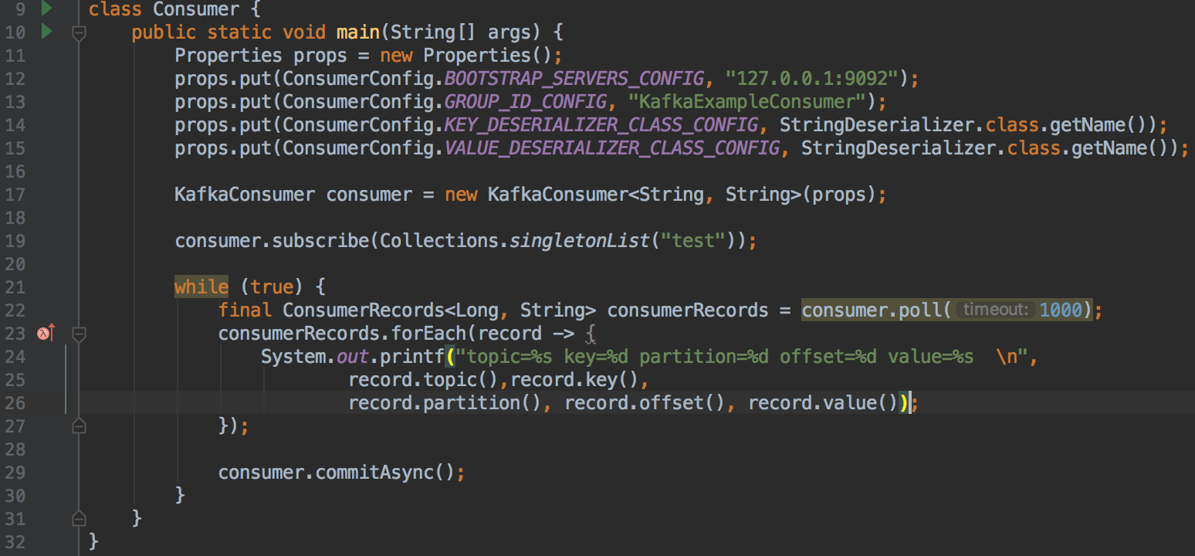
Java consumer
Notes:
import org.apache.kafka.clients.consumer.ConsumerConfig; import org.apache.kafka.clients.consumer.ConsumerRecords; import org.apache.kafka.clients.consumer.KafkaConsumer; import org.apache.kafka.common.serialization.StringDeserializer; import java.util.Collections; import java.util.Properties; class Consumer { public static void main(String[] args) { Properties props = new Properties(); props.put(ConsumerConfig.BOOTSTRAP_SERVERS_CONFIG, "127.0.0.1:9092"); props.put(ConsumerConfig.GROUP_ID_CONFIG, "KafkaExampleConsumer"); props.put(ConsumerConfig.KEY_DESERIALIZER_CLASS_CONFIG, StringDeserializer.class.getName()); props.put(ConsumerConfig.VALUE_DESERIALIZER_CLASS_CONFIG, StringDeserializer.class.getName()); KafkaConsumer consumer = new KafkaConsumer<String, String>(props); consumer.subscribe(Collections.singletonList("test")); while (true) { final ConsumerRecords<Long, String> consumerRecords = consumer.poll(1000); consumerRecords.forEach(record -> { System.out.printf("topic=%s key=%d partition=%d offset=%d value=%s \n", record.topic(),record.key(), record.partition(), record.offset(), record.value()); }); consumer.commitAsync(); } } }

Slide 17
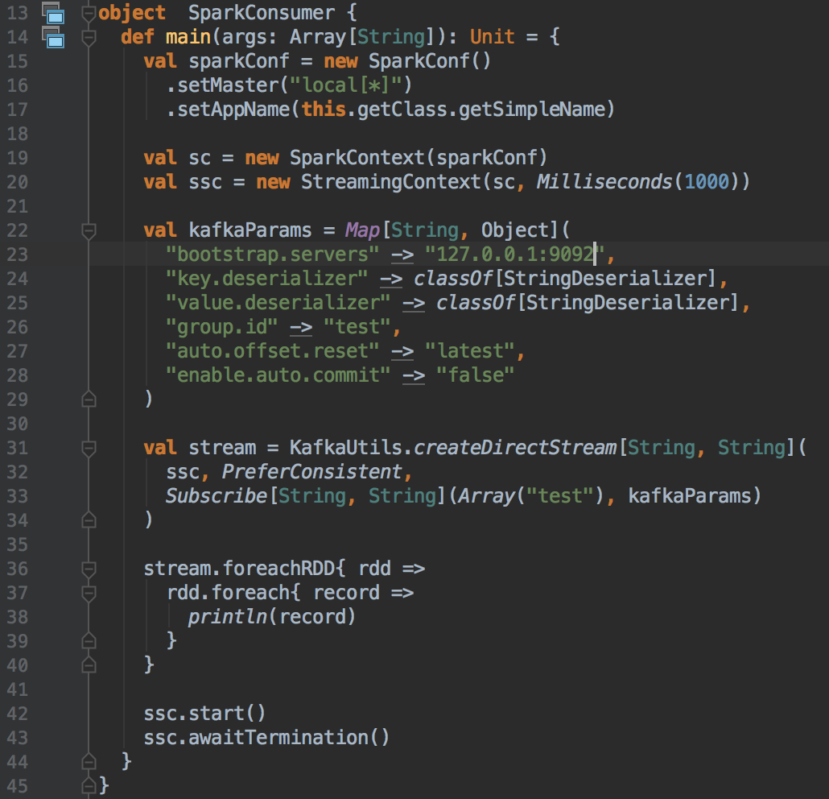
Scala Spark Streaming
Rdd to partiotion

Slide 18
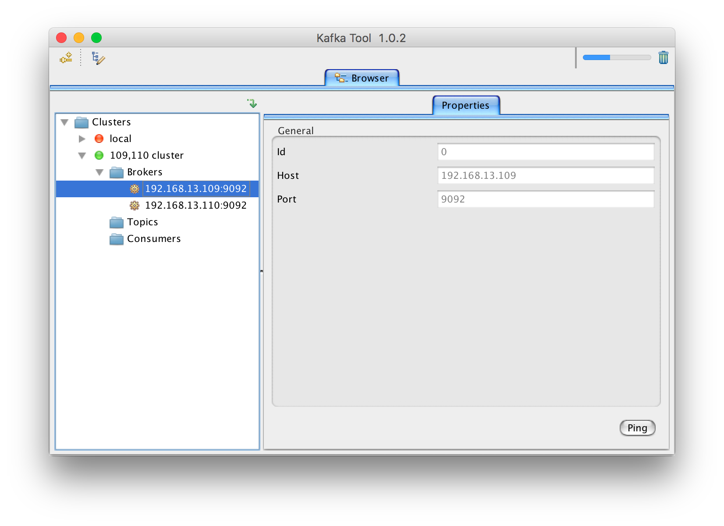
Multi-node cluster setup
Resources: 192.168.13.{109,110} servers
Change parameters on each node:
kafka/config/server.properties :
broker.id={x}
listeners = PLAINTEXT://{hostname}:9092
advertised.listeners = PLAINTEXT://{hostname}:9092
zookeeper.connect = {zookeeper_endpoint}:2181

Slide 19
Thank you for your attention!
Questions?
Code: https://github.com/vipmax/kafka_keynotes
Max Petrov
+79213676742
Notes:
Open the 9 slideon X Axis it is shown numerical values of iteration, what does it mean?
You can consider in as a time, we split each day by 4 itetations and here is about 1 week of simulation
how did you collect datas and what it size??
we collected data with our own data colleection system, we call it osn Crawler, it is distributed system that can effectivly collect data from varios osn for example vk.com, twitter, instagram, if you intresting we can discuss it more at coffee break in more detaled

